Slide 1

2026 Mid-Winter Meeting
Reports and Reports and Per Capita

Slide 2
2026 SOC Meeting Reports 1
17 Councils still haven’t file Report of Officers (Form 185)
34 Councils still haven’t filed Service Personnel (Form 365)
33 Councils didn’t file for Columbian Award last year (SP-7)

Slide 3
2026 SOC Meeting Reports 1
Reports to State Deputy
  What Reports to copy
    Form 186
    Form 365
    Form 1295
    Form SP-7
    Form 1728
    Form 10784
    FOM
  What not to copy
    Form 100
    State Program Entries
    State FOY Entries
    State KOY Entries
Where to Send : reports@kofc-ms.org

Slide 4
2026 SOC Meeting Reports 2
Reports for Minute Books
Who Should File (If you were in one of these positions for the 2024-5 fraternal year):
  District Deputies
  Grand Knights
  State Program Chairs
What happens if they are not submitted?

Slide 5
2026 SOC Meeting Reports 2
Reports for Minute Books
  Council 1234
  Joe Smith GK
  No Report

Slide 6
2026 SOC Meeting Reports 2
Reports for Minute Books
  District Deputy 18
  Fred Higgenbothum
  No Report

Slide 7
2026 SOC Meeting Reports 2
Reports for Minute Books
  State Swim Team
  Chairman Billy Bob Jones
  No Report

Slide 8
2026 SOC Meeting Reports 2
Reports for Minute Books
  What to Report
    Activities
    Programs
    Significant Accomplishments
  What Not to Report
    Council budget
    Results of Fundraisers
    Member Deaths

Slide 9
2026 SOC Meeting Per Capita
Per Capita Bills are ready
Insurance charges
  Billing Period Changed – 6 months later February 2026
  Current Bill through January 2027
  Billing Period Changed AGAIN – October 2026
  July Bill will include charges for 8 months
  Next Bill July 2027
Sorry

Slide 10
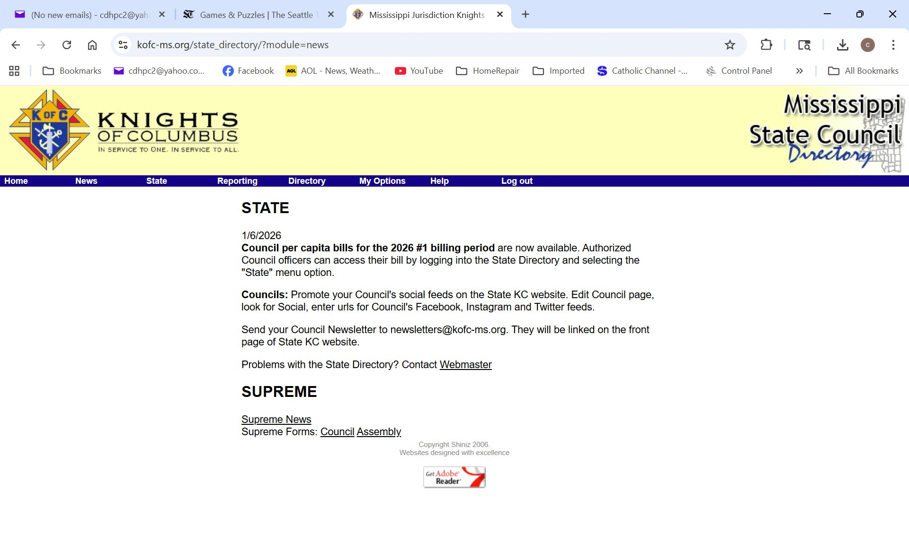
2026 SOC Meeting Per Capita

Slide 11
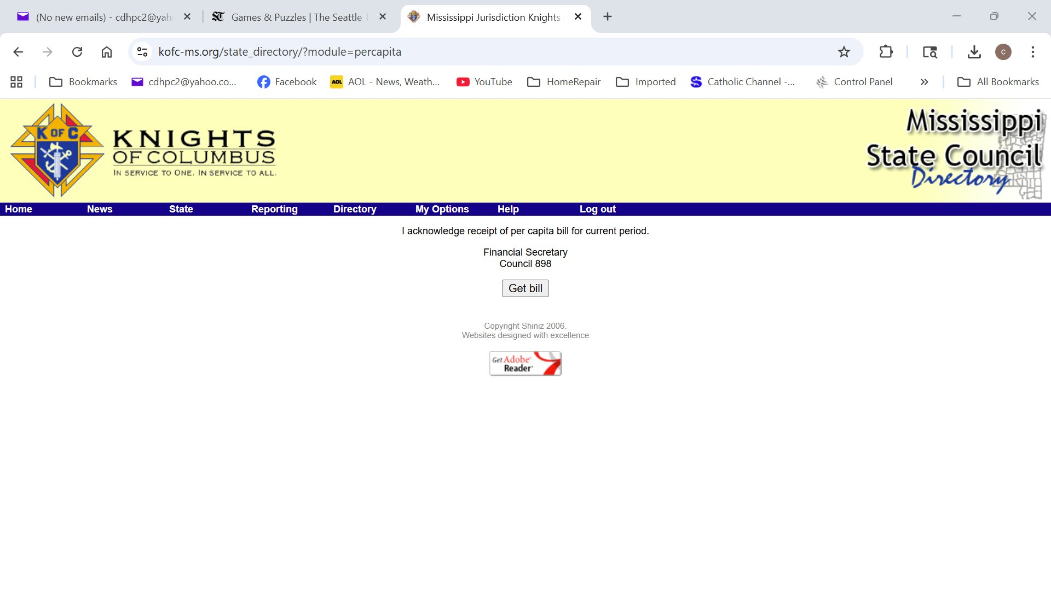
2026 SOC Meeting Per Capita

Slide 12
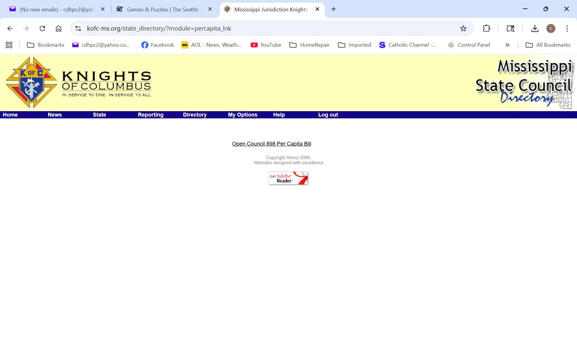
2026 SOC Meeting Per Capita

Slide 13
2026 SOC Meeting
Questions?
Charles Hahn
601-831-1057
cdhpc2@yahoo.com

